Slide 1
CodeSphere:
A Real-Time Developer Collaboration Platform
(Course Code: 25CS022)
Presented By:
Parth Sharma (2411981406)
Raghav sharma(2411981446)
Parshiv Guleria(2411981403)
Nimish Tayal(2411981382)

Slide 2
Index
Introduction
Project Description
System Architecture & Design
Database Design
Data Flow Diagrams (DFD)
Features Implemented
Screenshots
Challenges Faced
Pending Tasks
Conclusion

Slide 3
Introduction
Modern Agile Collaboration: Modern software development requires seamless communication, efficient task management, and real-time collaboration among distributed development teams.
Project Purpose: To develop an enterprise-grade developer collaboration platform that integrates project management, task tracking, team communication, and file sharing within a unified workspace.
Enterprise Security Standard: Implements JWT-based authentication, encrypted password storage using bcrypt, and Role-Based Access Control (RBAC) to ensure secure access management.
Real-time State Sync: Uses Socket.IO to provide instant updates for messages, task modifications, notifications, and project activities without requiring manual page refreshes.

Slide 4
Project Description
Problem Statement :
Existing collaboration platforms often require multiple tools for communication, task management, document sharing, and project tracking, increasing complexity and reducing team productivity.
Existing Platforms:
Jira: Extremely complex interface with a steep learning curve for lightweight development teams.
Trello: Excellent task management but lacks integrated real-time communication and advanced collaboration features.
Discord: Provides communication but does not support structured project and task management.
GitHub: Excellent version control platform but lacks comprehensive team collaboration and workspace management.
Proposed Solution : CodeSphere
Centralized Workspace Management
Real-Time Team Communication
Secure File Sharing
Task & Project Management

Slide 5
System Architecture & Design
Frontend Tier: React.js, Tailwind CSS, React Router, Axios, and React Beautiful DnD for responsive user interface and task management.
Backend Tier: Node.js runtime with Express.js REST API controllers and Socket.IO server for real-time communication.
Persistence Layer: MongoDB cluster managed through Mongoose ODM schemas.
Cloud Storage: Cloudinary integration for storing project documents, images, and attachments.

Slide 6
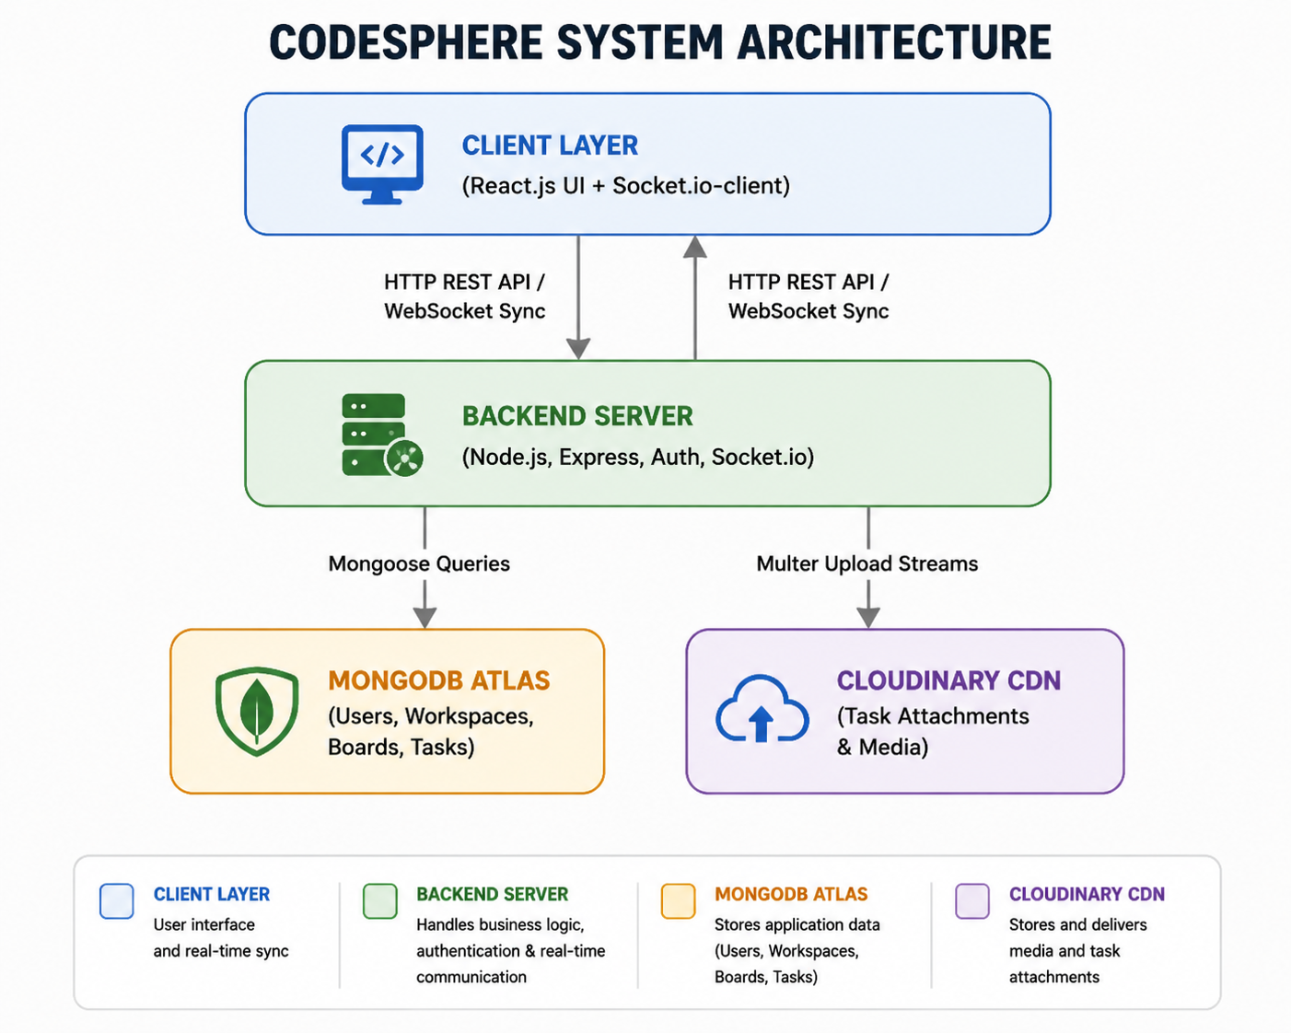
System Architecture & Design

Slide 7
Database Design
Collection | Key Fields & Data Types | Relationships & Constraints
Users | Name, email Unique), password (Hashed), role (Admin/Member/Viewer) | Primary authentication entity. Linked to Workspaces.
Workspaces | Title, description, ownerId (Ref: User), members (Array of Ref: User) | 1-to-N relationship with Boards and User Roles.
Boards | Name, workspaceId(Ref: Workspace), columns (Array of Strings) | 1-to-N relationship with Tasks; ordered column array.
Tasks | Title, boardId, columnId, priority, assignees, attachments | Referential index on `boardId` and `columnId` for fast queries.

Slide 8
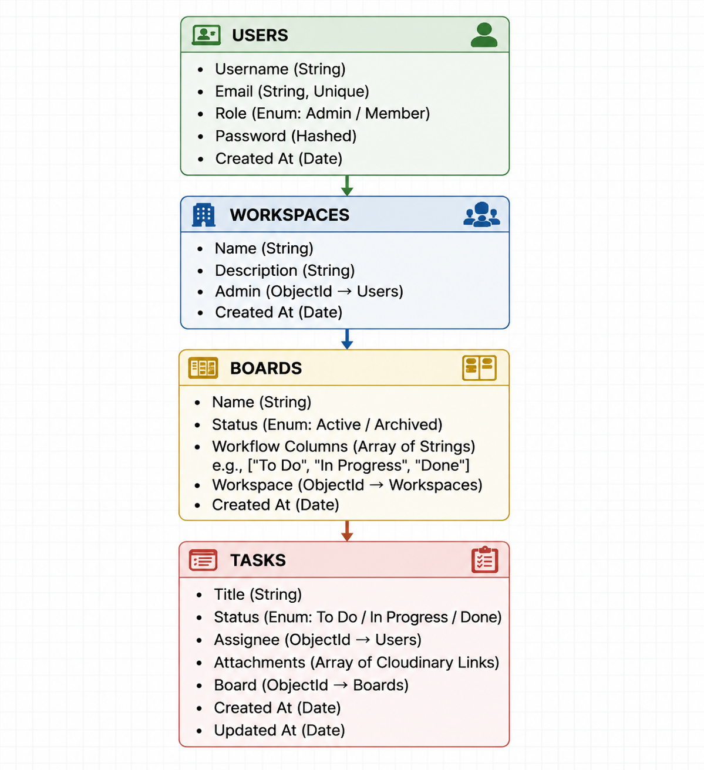
Database Design

Slide 9
Data Flow Diagrams (DFD)
Level 0 DFD (Context Level): Represents the interaction between users and the CodeSphere collaboration platform.
[ User / Admin ]
↓ HTTP REST API Requests / WebSocket Events ↑
[ CodeSphere Backend Engine ]
↓ CRUD Operations • Authentication • File Storage ↑
[ MongoDB Atlas & Cloudinary ]
Level 1 DFD (Process Deconstruction): Breaks down core backend processes into subprocesses:
P1.0 Auth Subsystem: Token issuing & Verification.
P2.0 Workspace Controller: Board & Member Management.
P3.0 Task Pipeline: CRUD & Column State Updates.
P4.0 Socket Dispatcher: Live Event Broadcasting.

Slide 10
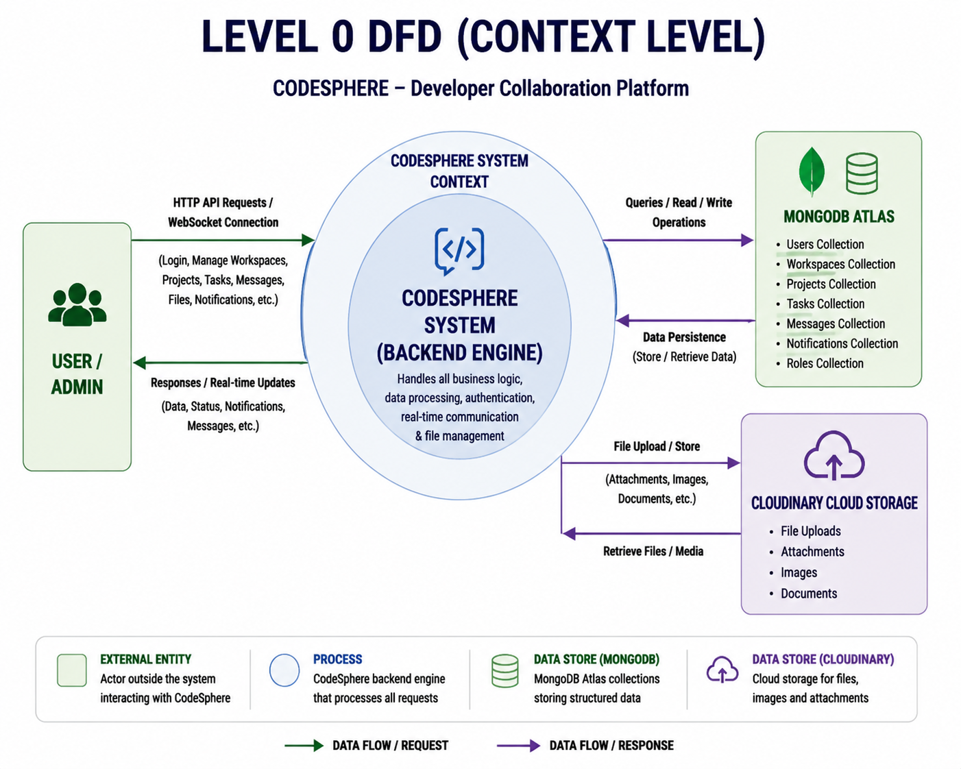
Level 0 DFD (Context Level)

Slide 11
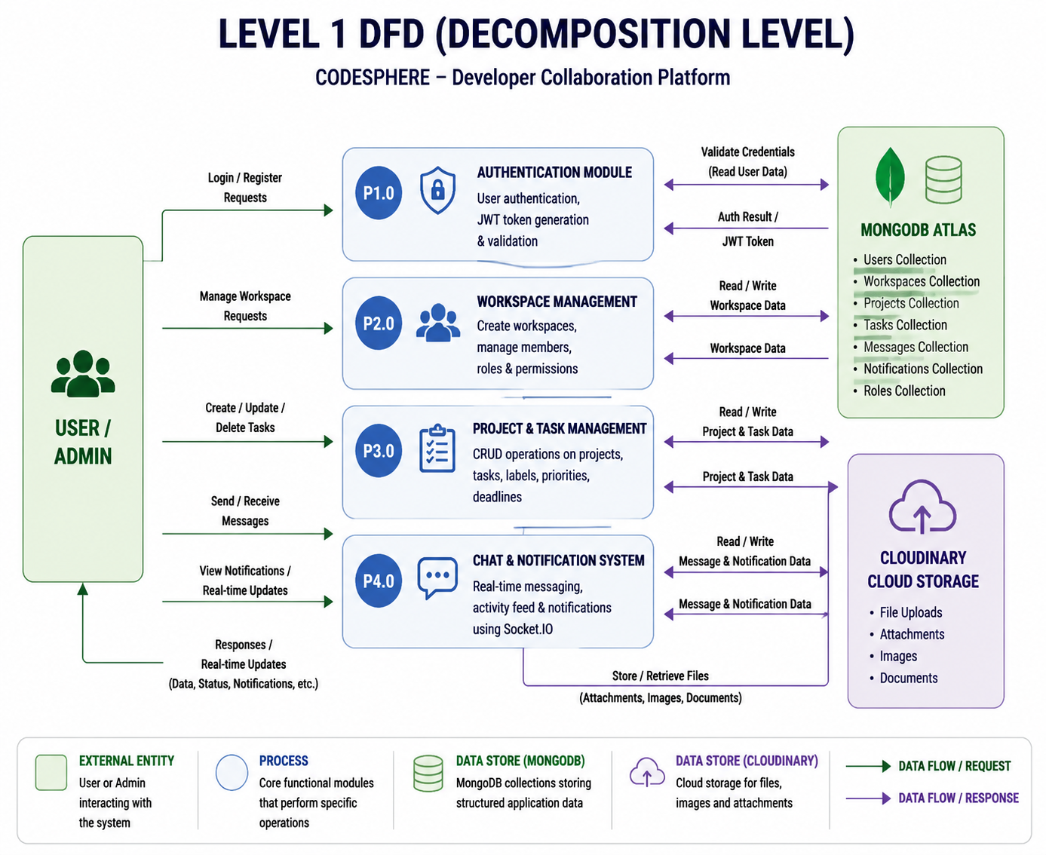
Level 1 DFD (Process Deconstruction)

Slide 12
Features Implemented
Workspace & Board Structure: Create workspaces, invite members, assign roles, and manage team collaboration.
Project & Task Management: Create projects, assign tasks, manage deadlines, labels, priorities, and progress tracking.
Real-Time Communication: Instant messaging, activity notifications, and live project updates using Socket.IO.
File Management: Cloudinary integration for uploading and sharing project documents securely.
AI Project Assistant:An intelligent module that analyzes project data, task progress, and team activities to provide AI-based recommendations. It helps developers prioritize tasks, predict possible delays, and improve overall project management efficiency.

Slide 13
Challenges Faced
Real-Time Synchronization: Handling simultaneous task updates and message delivery without data inconsistency.
Database Optimization: Efficiently managing complex relationships between users, workspaces, projects, and tasks.
Authentication Security: Implementing secure JWT middleware and role-based authorization.
File Storage: Managing cloud uploads while maintaining high performance.
API Scalability: Designing modular REST APIs capable of supporting future feature expansion.

Slide 14
Pending Tasks
Backend API Development: Implement REST API routes for authentication, user workspaces, and task CRUD operations.
Database & Schema Integration: Set up MongoDB collections using Mongoose models for Users, Boards, and Tasks.
Real-Time WebSocket Integration: Configure Socket.io on the backend to broadcast live card and column updates.
Frontend UI Construction: Build responsive React components with @hello-pangea/dnd for smooth drag-and-drop board interactions.
File Upload Pipeline: Integrate Multer and Cloudinary to handle task attachments and media uploads.

Slide 15
Conclusion
Centralized Collaboration Platform: Successfully designed a scalable platform combining project management, communication, and task tracking.
Secure System Architecture: Implemented JWT authentication, PostgreSQL database management, and secure cloud storage.
Real-Time Collaboration: Enabled instant communication and synchronized project updates using Socket.IO.
Ready for Enterprise Deployment: The modular architecture allows seamless expansion with AI services, DevOps integration, and cloud deployment.

Slide 16
Thank You

